Slide 1


Slide 2

Topics
Linear Regression
Optimization vs estimation algorithms
Gauss-Markov assumptions (Review)
OLS vs WLS vs PLS vs GLS
LR Validation and model diagnostics

Slide 3
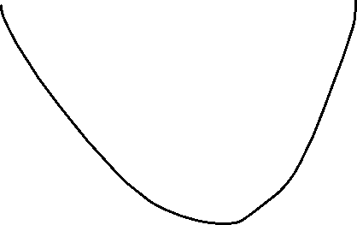






Slide 4
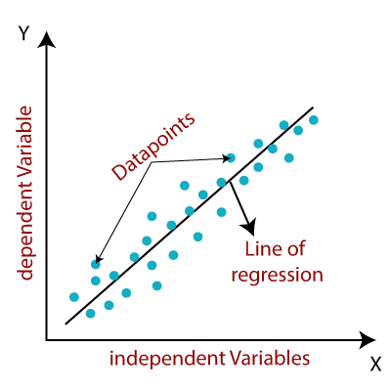
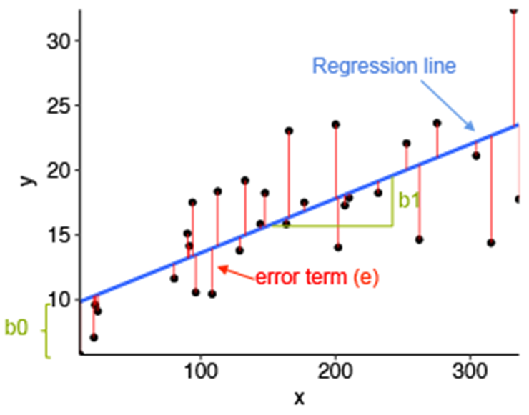
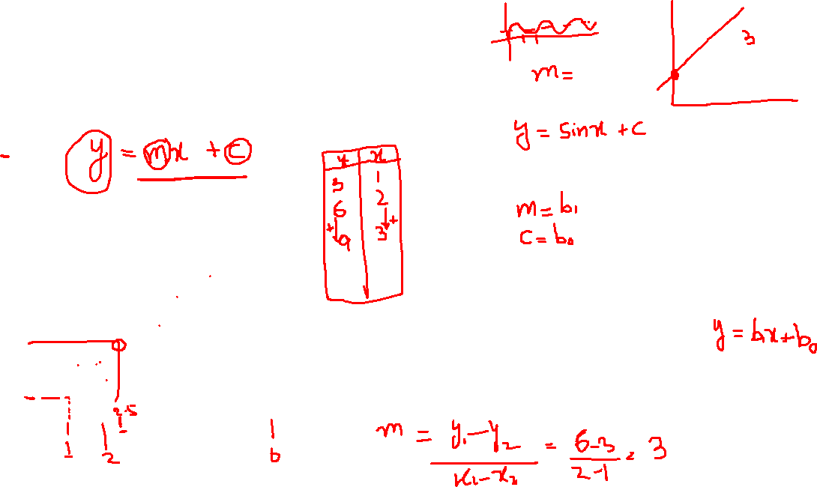
What is Linear Regression
Linear Regression fits a straight line through the data.
Notes:
Predicting continuous numerical values.
Algorithms : Multi-Linear regression, Polynomial Regression, Regularized Regression, Poisson Regression, Gamma Regression,
Examples :
House Price Prediction
Drink Quality Prediction
Air Quality Prediction
Income Prediction

Slide 5
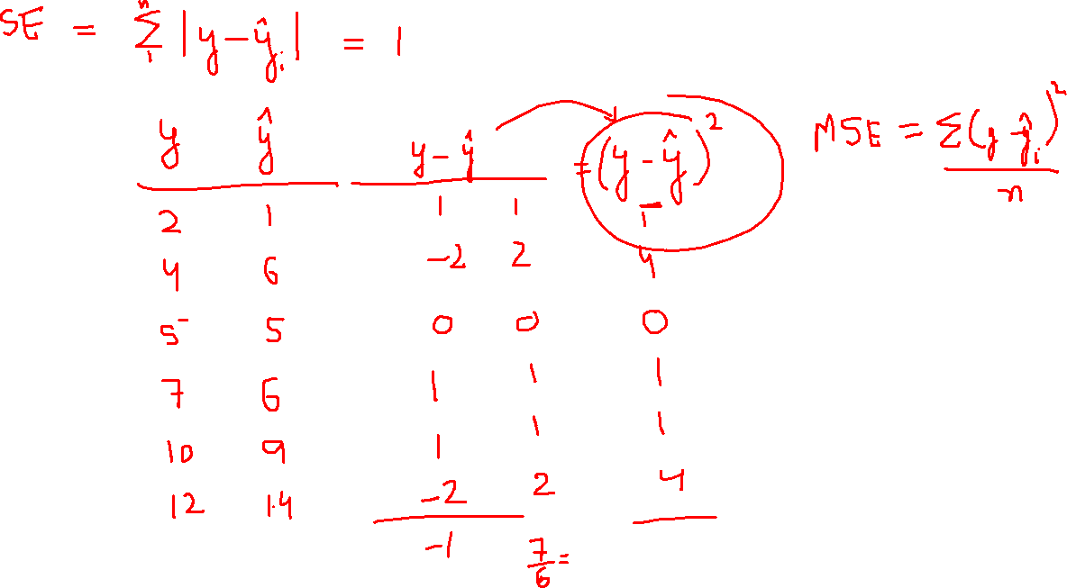

Slide 6
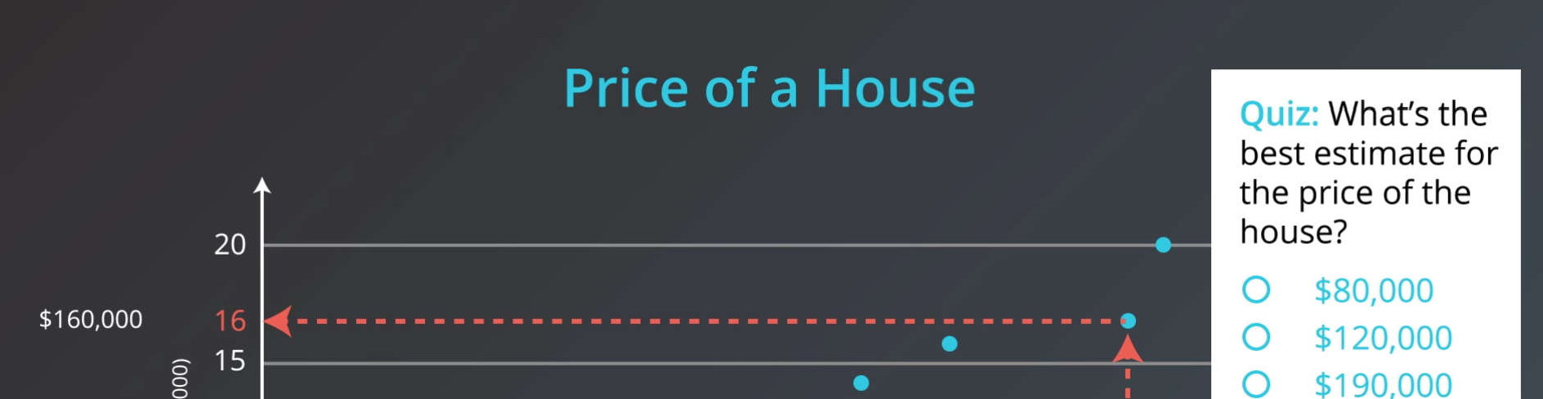
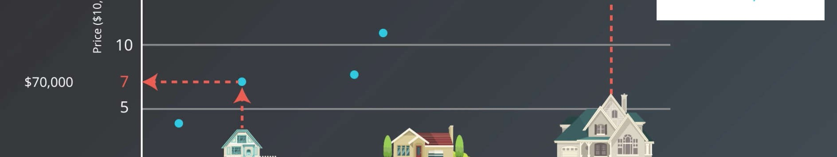

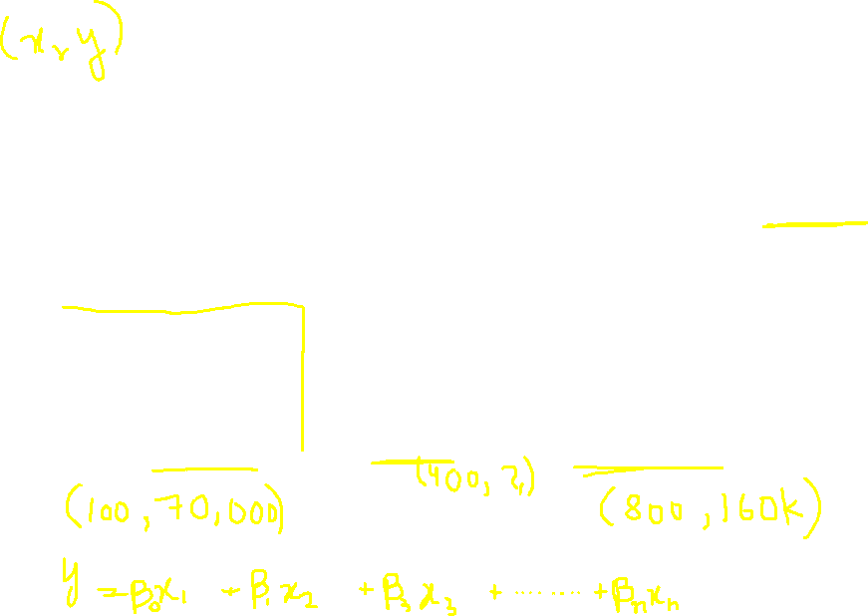
Notes:
https://www.youtube.com/watch?v=1wekohJ5nqA&ab_channel=MashupMath

Slide 7
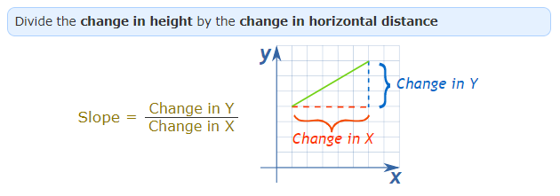
6
5
Intercept, A Point where Line will Cross y Axis
4
Slope, How change in X can impact change in Y
3
Y Axis
1
Y = mx + C
Y = Slope * x + Intercept
0
6
1
2
3
4
5
X Axis
Notes:
https://www.mathsisfun.com/geometry/slope.html

Slide 8
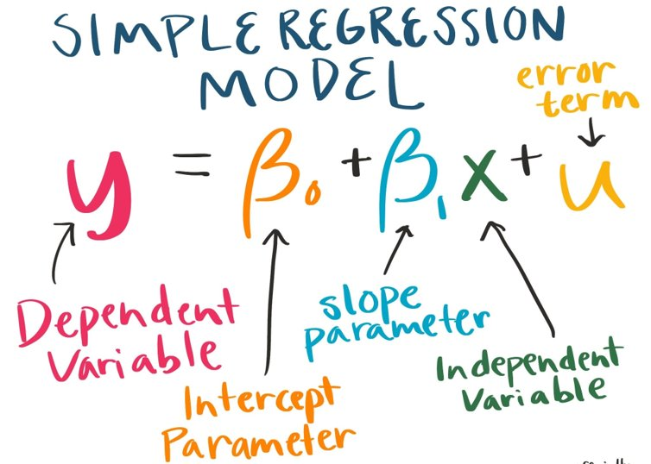


Slide 9
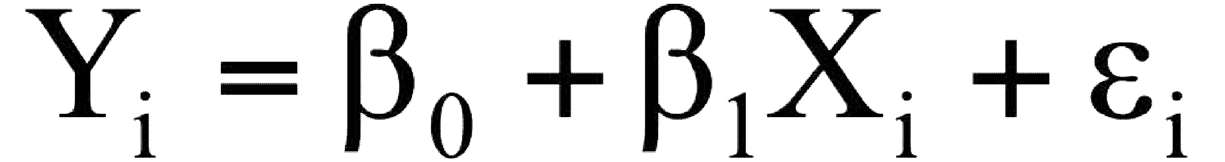

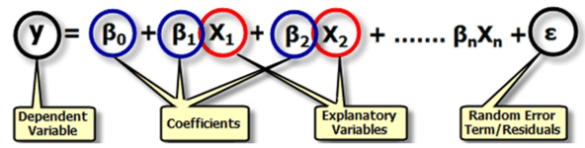
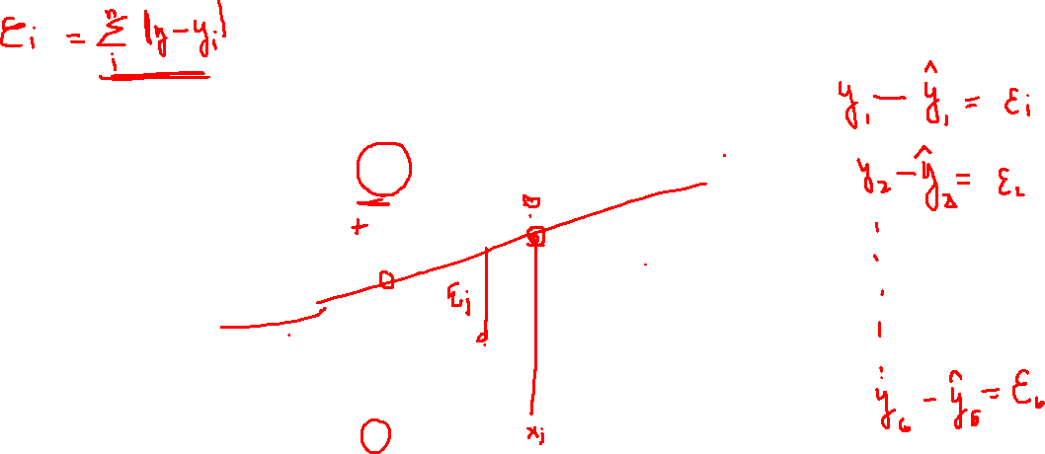
Y
Observed Value of Y for X_{i}
ε_{i}
Slope = β₁
Predicted Value of Y for X_{i}
Error for this X_{i} value
Intercept = β₀
X_{i}
X
Same Equation
Notes:
https://hbr.org/2015/11/a-refresher-on-regression-analysis?referral=00060
Multiple Linear Regression

Slide 10
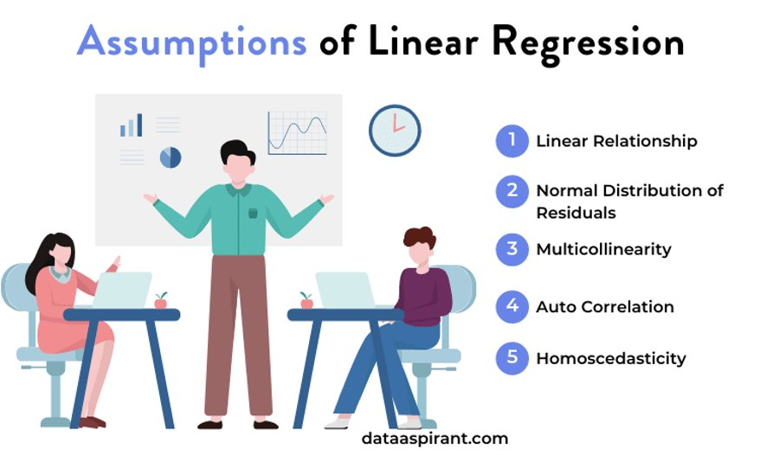
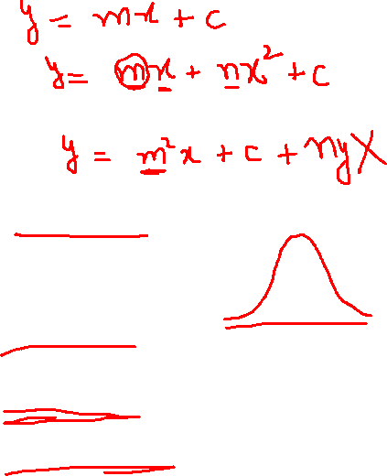
Gauss-Markov Assumptions
Notes:
The Gauss Markov assumptions guarantee the validity of ordinary least squares for estimating regression coefficients.
https://dataaspirant.com/assumptions-of-linear-regression-algorithm/
‘Important for statistical analysis

Slide 11
Optimization vs Estimation
Optimization is a general term for finding the maximum, or minimum, of some function.
It is broader, as you can use it without data, just by finding the maximum of some abstract function
Estimation is a statistical term for finding some estimate of unknown parameter, given some data.
This can be done using optimization methods, e.g. by maximizing the likelihood function, or minimizing a loss function.
Notes:
ML element in LR is added through optimization algorithm

Slide 12
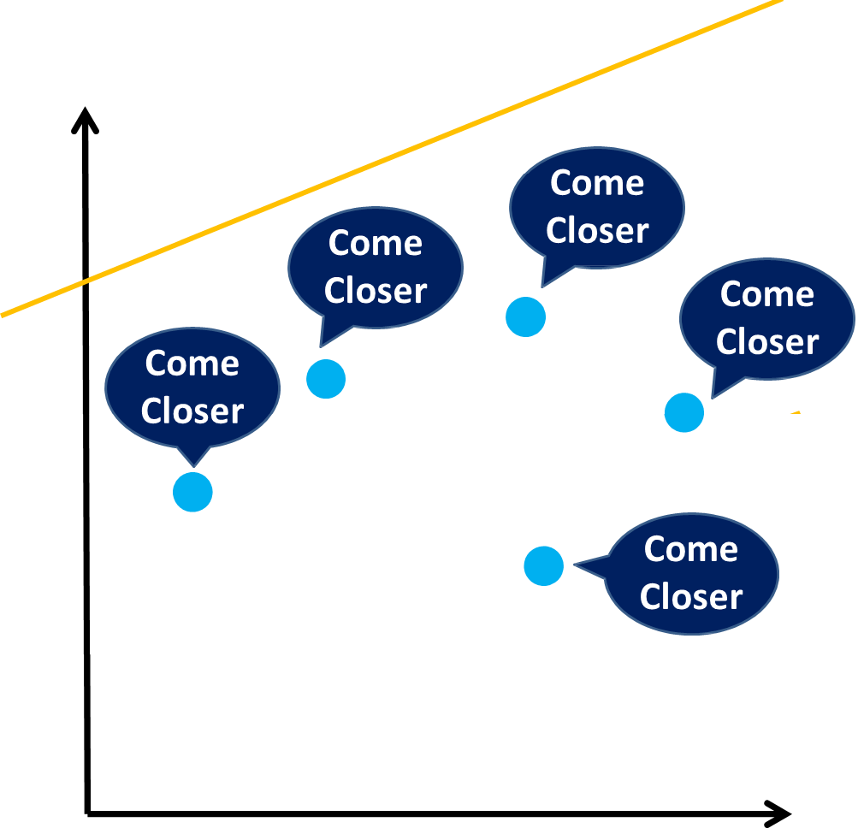
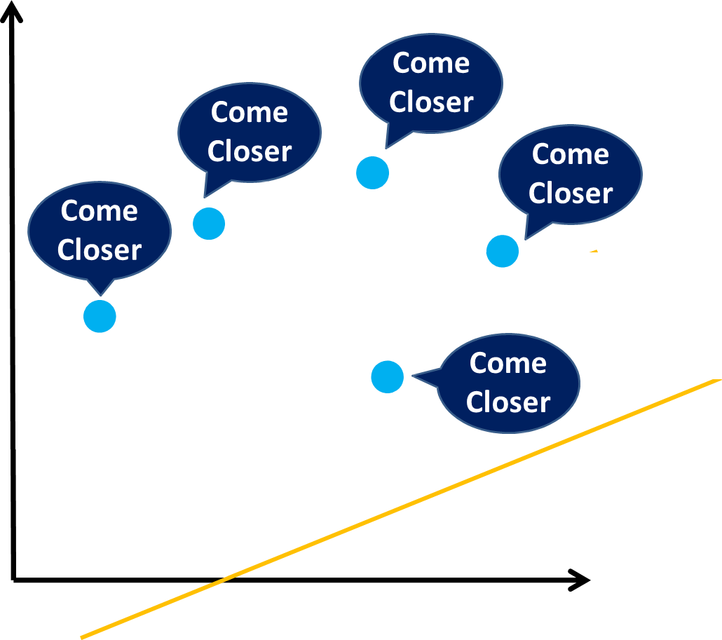
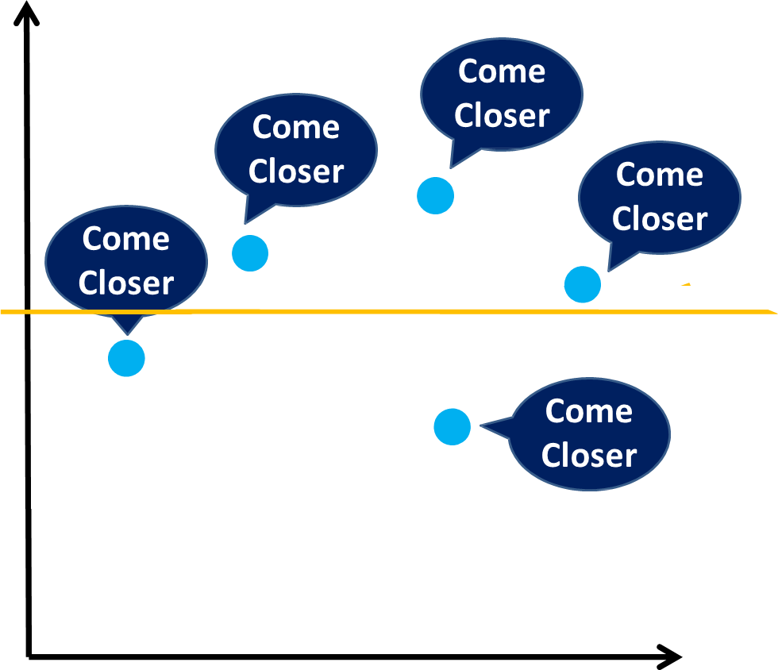
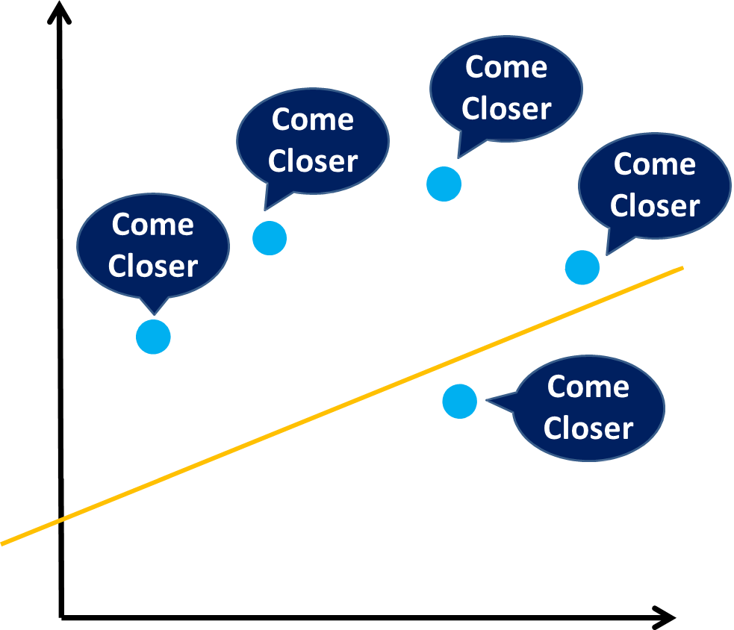
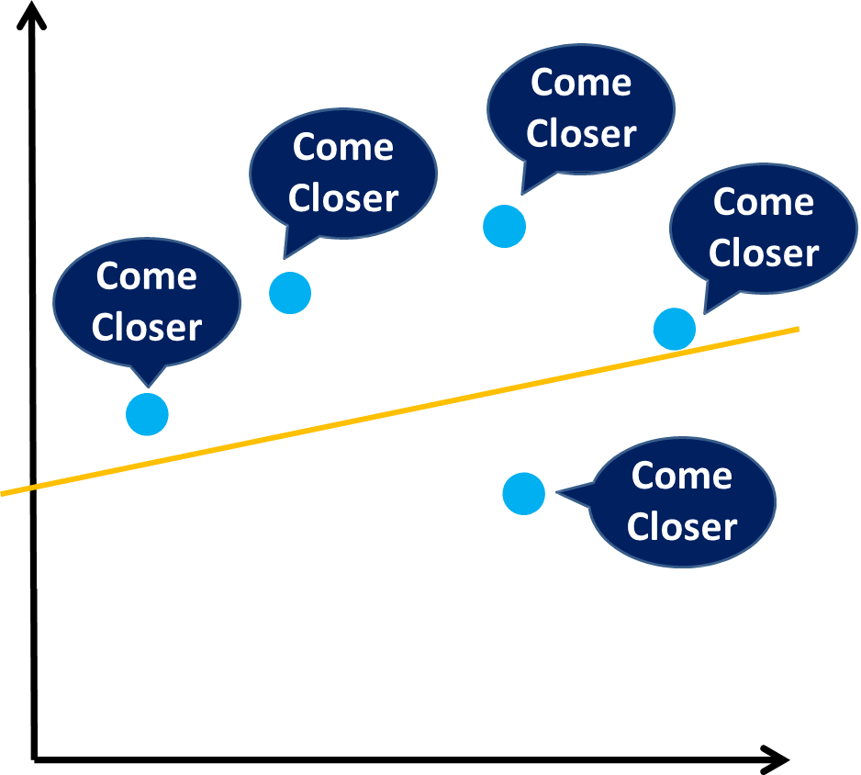
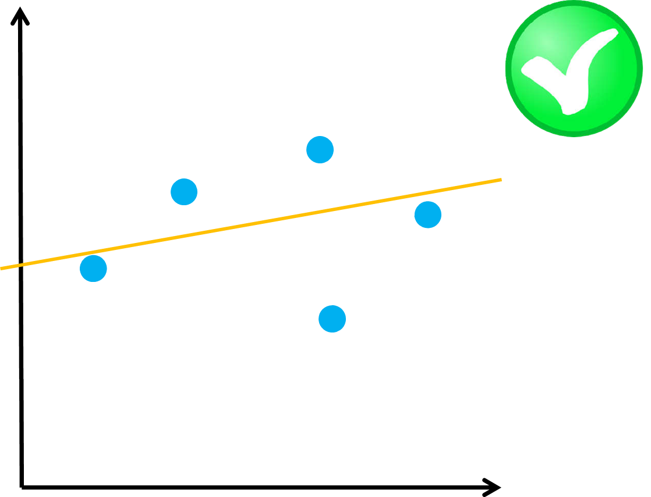
How to fit the best regression line?
Scenario #1
Scenario #2
Scenario #3
Scenario #4
Scenario #5
Scenario #6
Notes:
Fitting line multiple times through an iterative process to get to the best fit LR

Slide 13
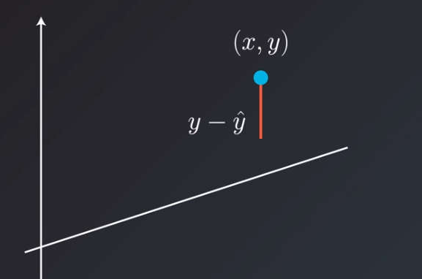
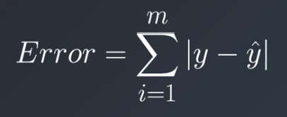
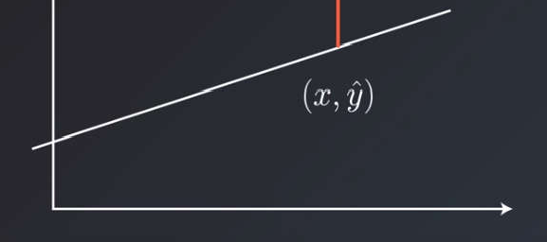
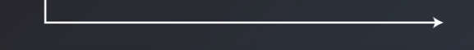
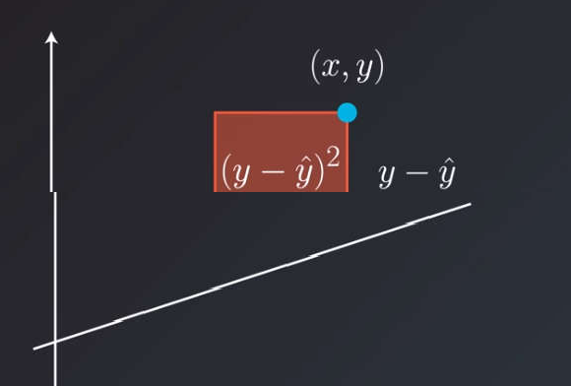
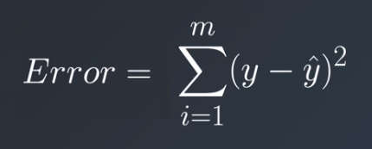
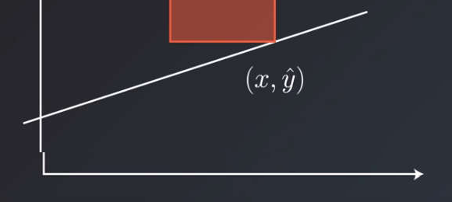
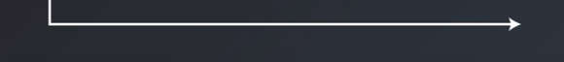
Find a line where Error is minimum through an iterative approach. What is an Error & How to Calculate it ?
Absolute Error
Squared Error

Slide 14
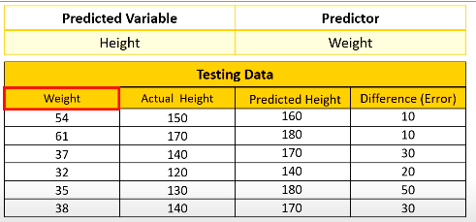
Weight is Independent Variable Called as Predictor
Height is Dependent Variable Called as Prediction
Error can be calculated by
Predicted - Actual
Absolute Error
Squared Error
Error can be calculated in Two Manners either in Absolute Values or in Squared Values

Slide 15
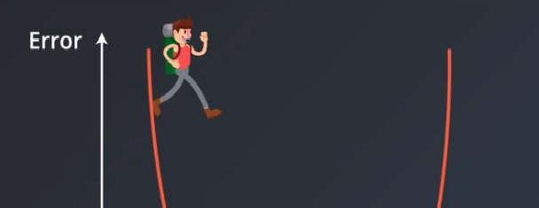
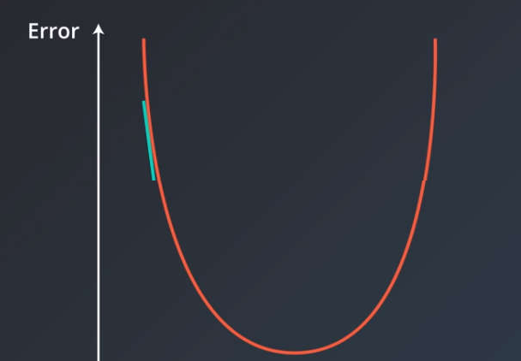
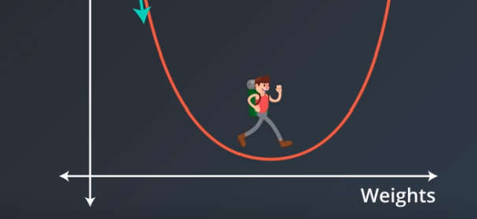

Best Regression Line Exist where the error is minimum.
Notes:
But how to get to bottom?

Slide 16

Introducing Gradient Descent
Notes:
https://www.youtube.com/watch?v=PA1hgWSPJBc

Slide 17
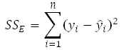
ERROR FUNCTION
ERROR FUNCTION CHANGES WITH A LEARNING RATE
Notes:
But how to get to bottom?
https://www.youtube.com/watch?v=PA1hgWSPJBc&ab_channel=NanodegreeIndia

Slide 18
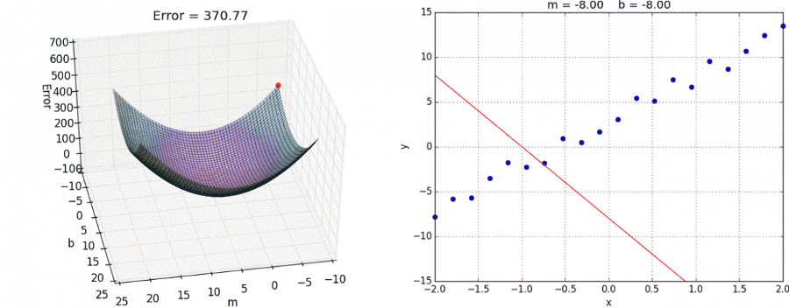
Notes:
https://www.mql5.com/en/articles/11200

Slide 19
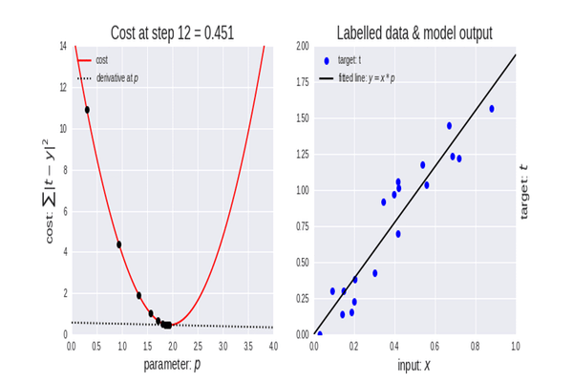
Notes:
https://www.mql5.com/en/articles/11200

Slide 20
OLS vs WLS vs PLS vs GLS
Generalized Least Square (GLS): When our simple linear regression model has the following characteristics:
Variance is not constant.
Data points are not independent of each other.
Residuals are correlated.
GLS regression can transforms the residuals, so the variances are equal and un-correlated.
Ordinary Least Square (OLS) is the most common estimation technique for linear regression. Using the regression formula:
y = mx + c
(OLS finds the slope and intercept that minimizes the mean squared error)
Penalized Least Square (PLS): Whenever we overfit our regression model, we need to penalize our model. The most common penalties for linear regression are:
L0 Penalty – Removes feature from the model but does not affect other coefficients.
L1 Penalty (Lasso) - Features are reduced equally. Low coefficients are removed.
L2 Penalty (Ridge) - Features are reduced proportionally, with the highest coefficient features reduced the most.
L1 + L2 (Elastic Net) - Combined the removal of low coefficients in lasso and the reduction of high coefficients in ridge
Notes:
Homework: WLS?

Slide 21
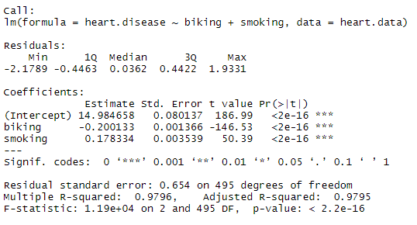
Linear Regression Validation & Diagnostics
Summary of the Linear Regression model:
Notes:
https://www.cienciasinseso.com/en/regression-model-diagnostics/

Slide 22
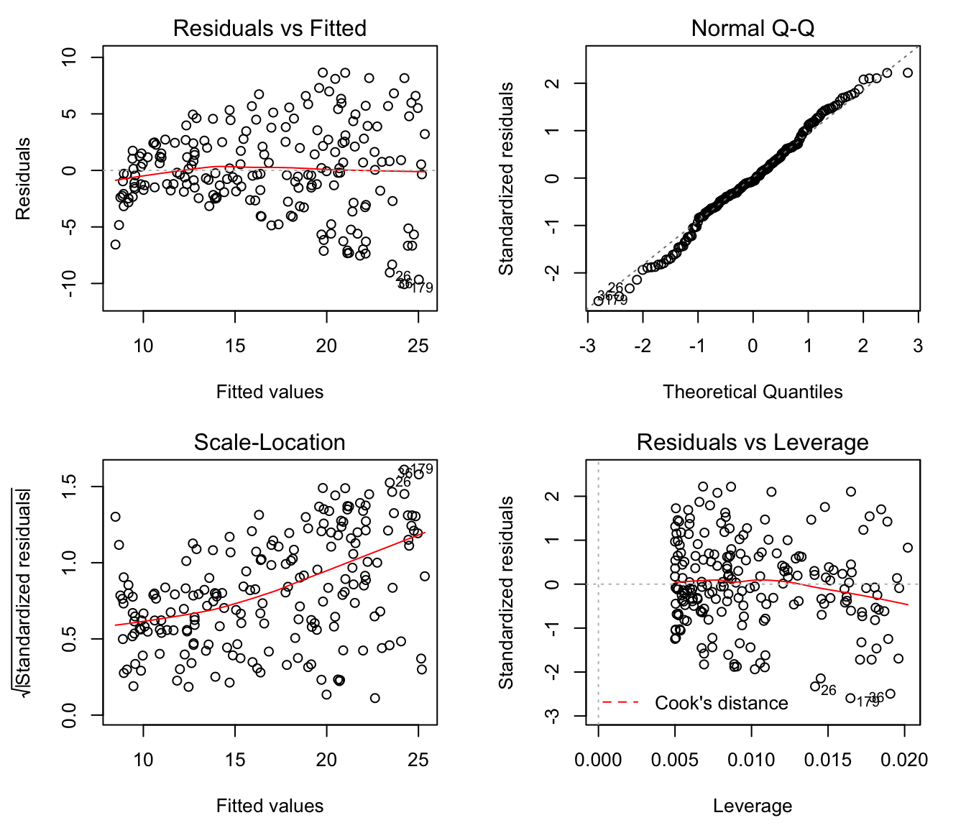
Linear Regression Validation & Diagnostics
Linear regression makes several assumptions about the data, these assumptions and potential problems can be checked by producing some diagnostic plots visualizing the residual errors.
Notes:
http://www.sthda.com/english/articles/39-regression-model-diagnostics/161-linear-regression-assumptions-and-diagnostics-in-r-essentials/

Slide 23

THANK YOU
Training and Certification

